Slide 1

Sororify
Smarter Matches, Stronger Sisterhood
Moriah Owens, Julia Foy, Amitha Soundararajan, Maya McFadden, Shay McDowell

Slide 2

Motivation
600 Potential New Members (PNMs)
Bump Group 1
Bump Group 2
Bump Group 3
Bump Group 4
Member 1
Member 2
Member 3
Member 4
Member 5
Member 6
Member 7
Member 8
Member 9
Member 10
Member 11
Member 12
Member 13
Member 14
Member 15
Member 16

Slide 3
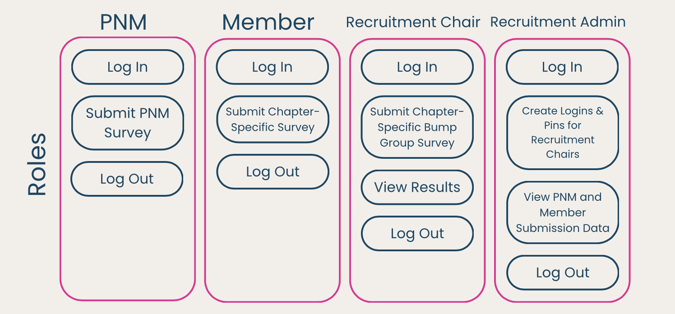
Sororify’s Solution

